Slide 1
Past New York State
Missing Children Poster Contest 1st Place Winners

Slide 2
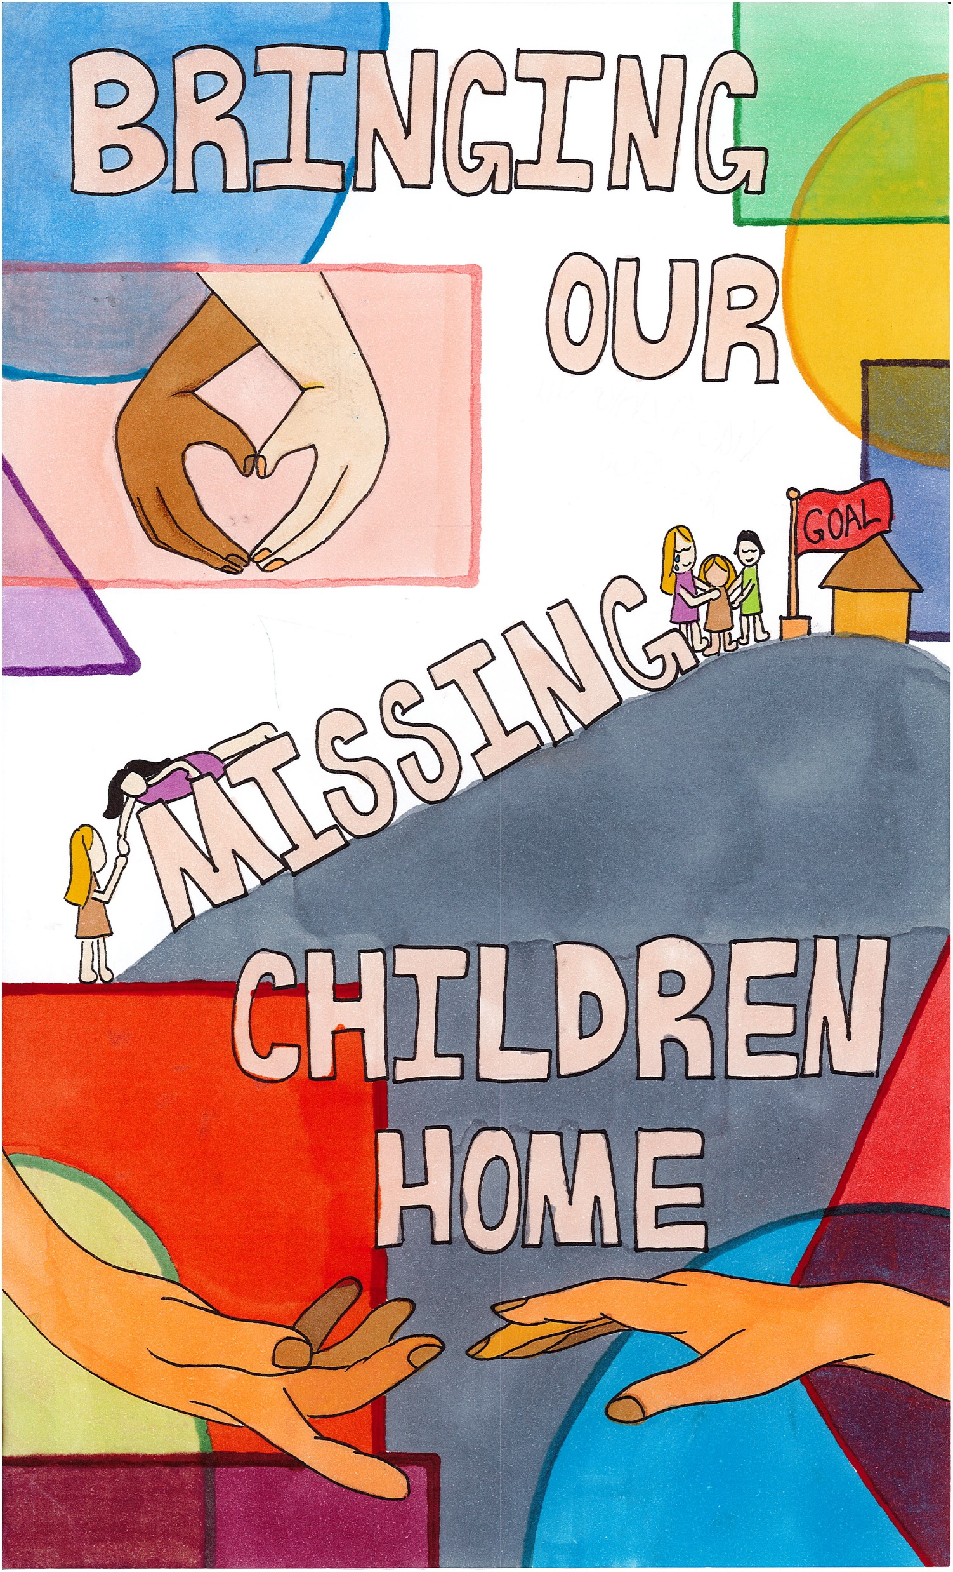
2024
XiaoQi Chloe Yu

Slide 3
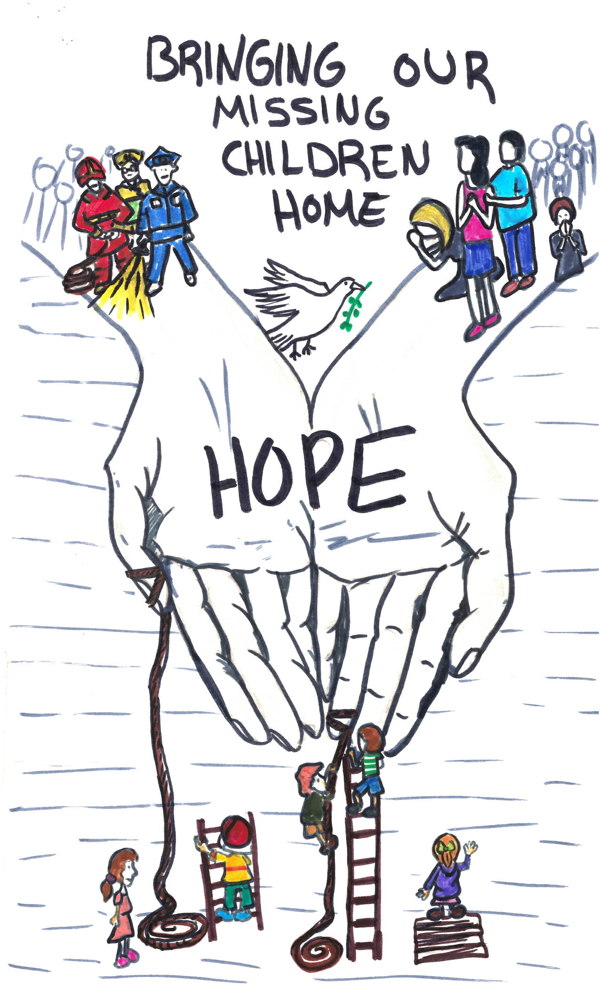
2023
Ayoub Alsaidi

Slide 4

2022
Rose Regula

Slide 5
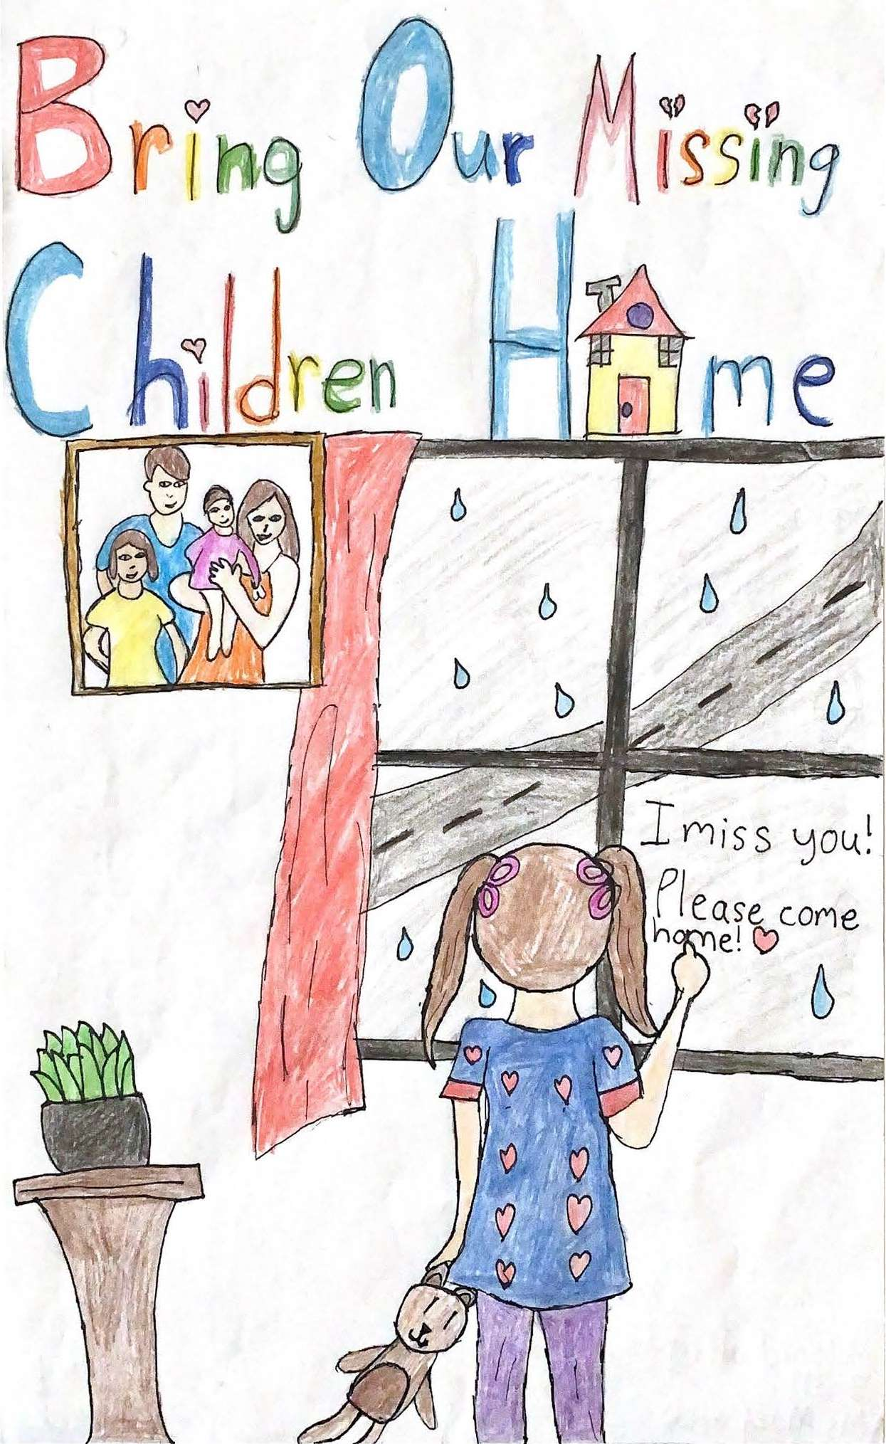
2021
Milani Rodriguez

Slide 6
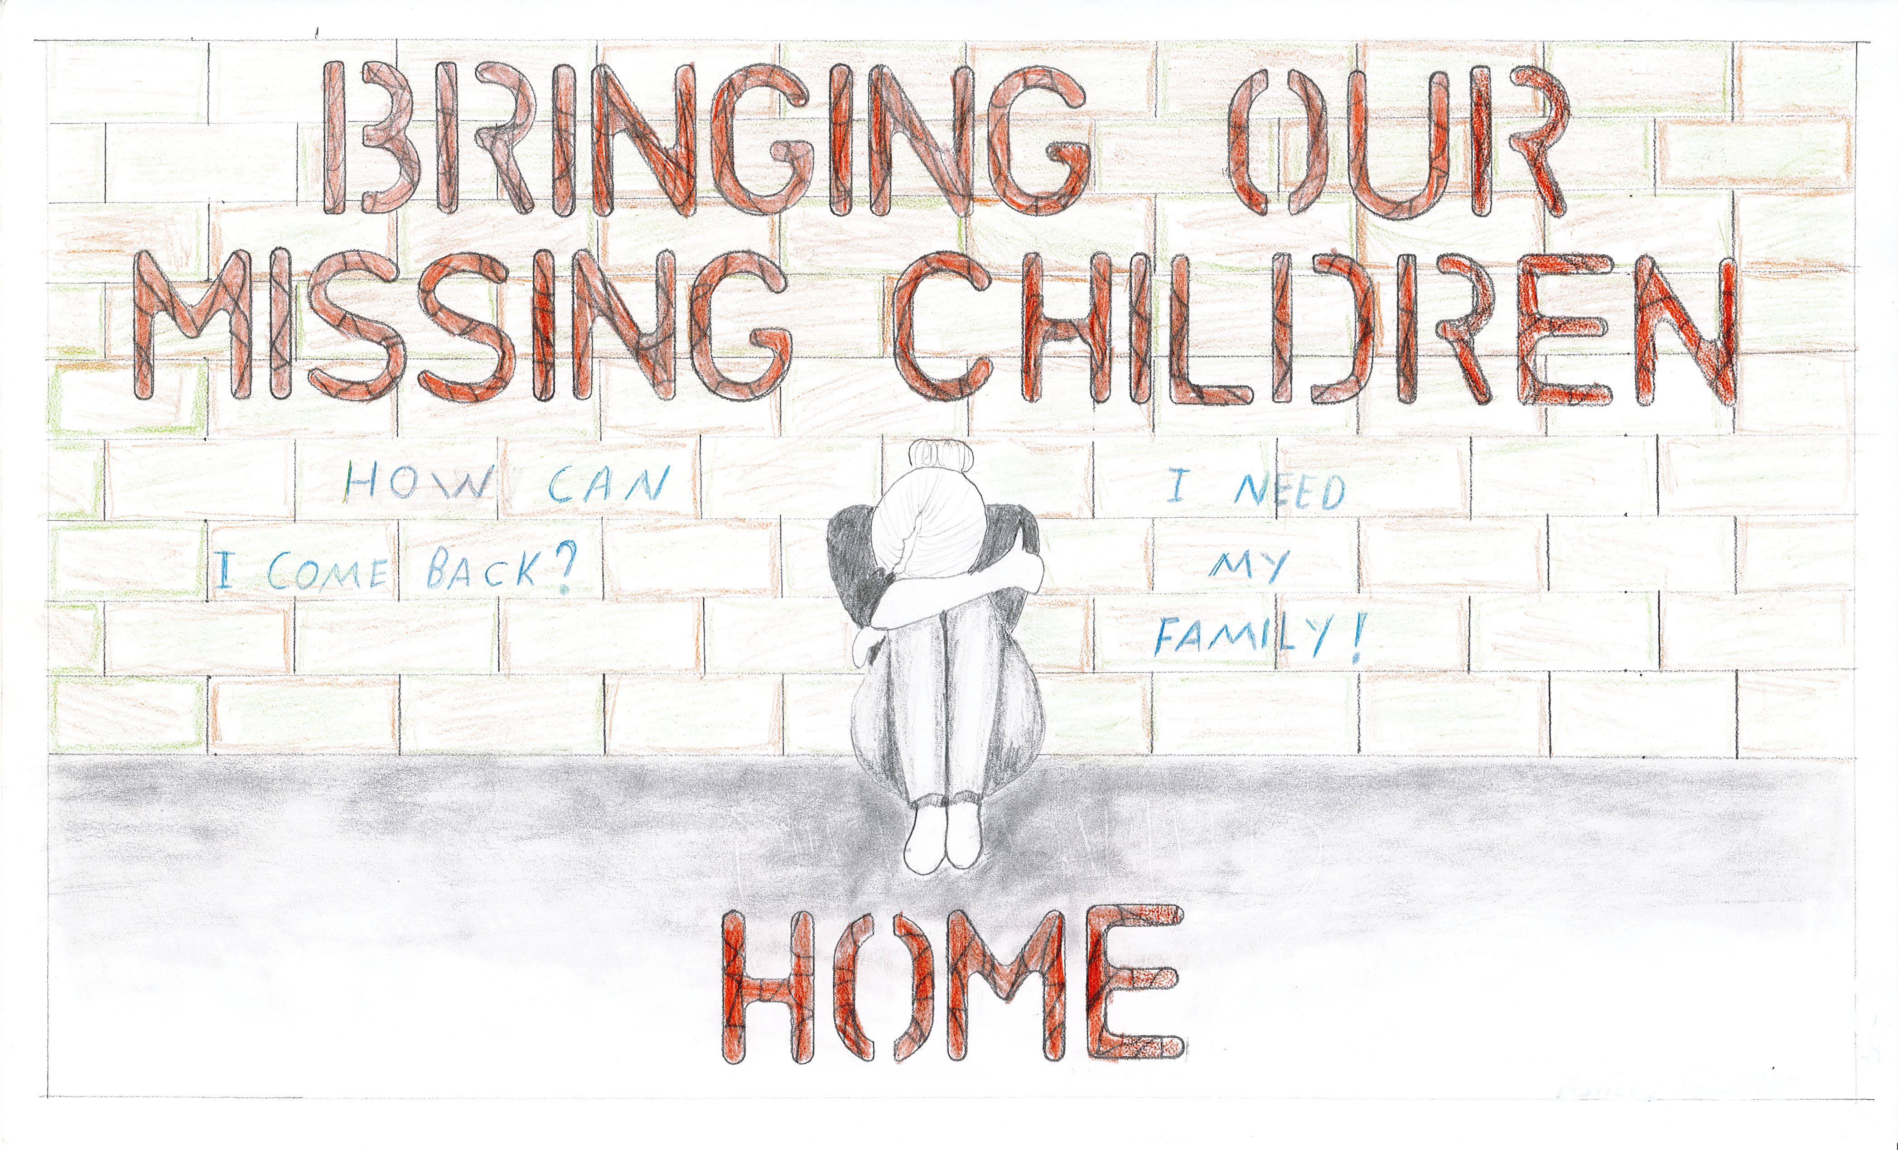
2020
Ashley Rosario

Slide 7
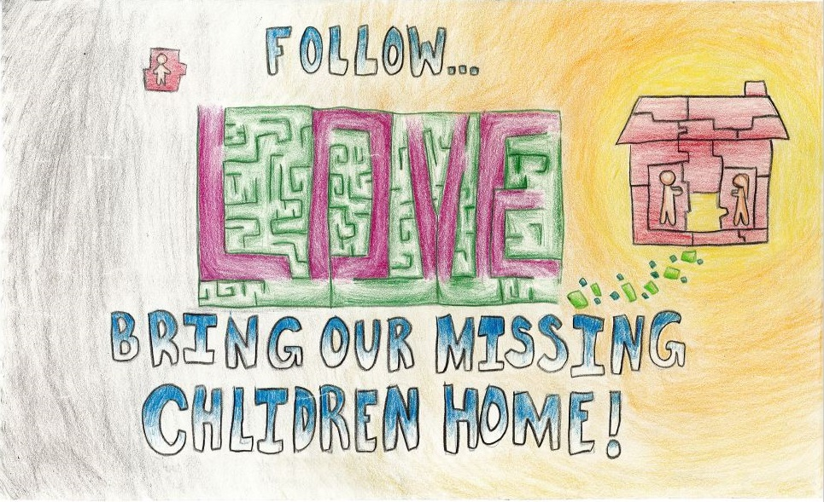
2019
Ella Jiang

Slide 8
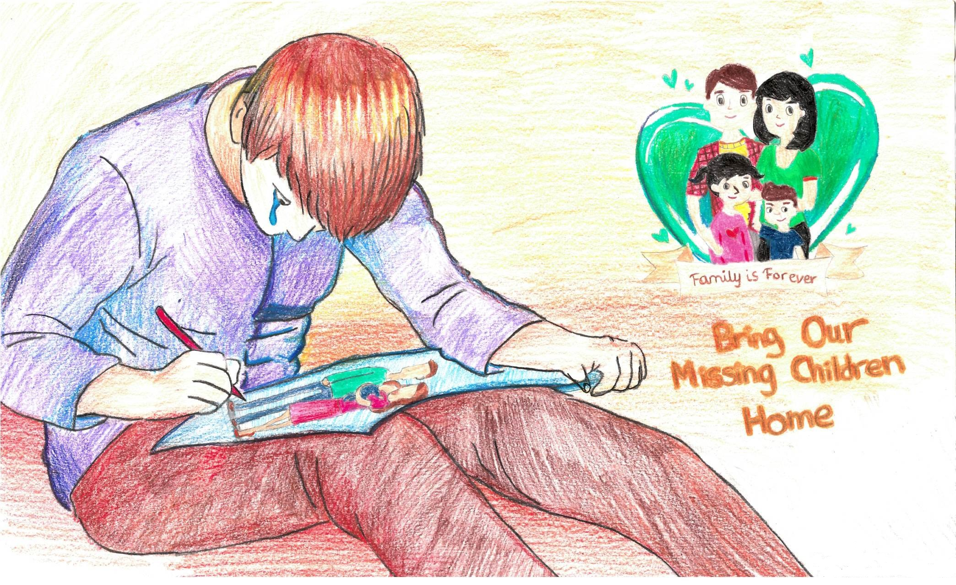
2018
Saranika Chakraborty

Slide 9
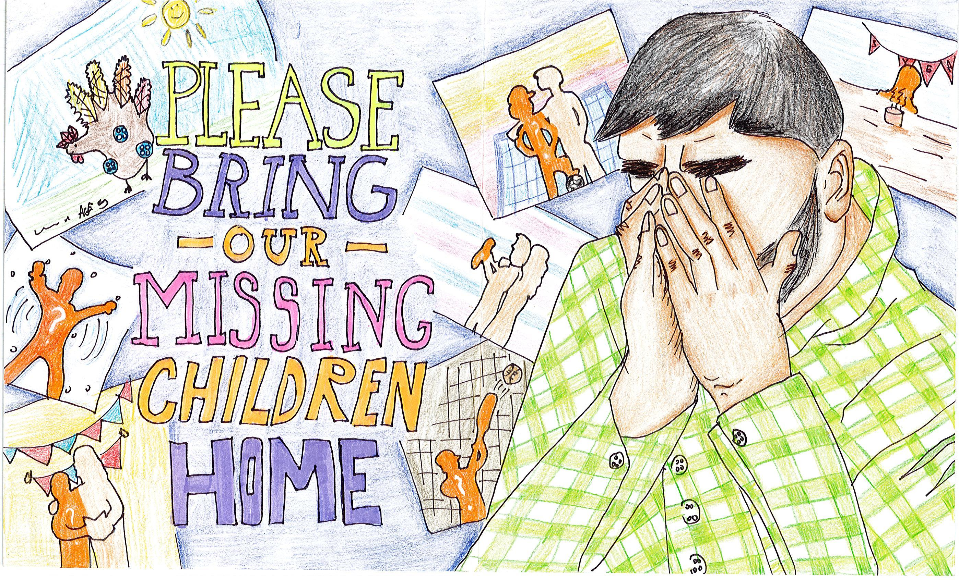
2017
Karen Lin

Slide 10
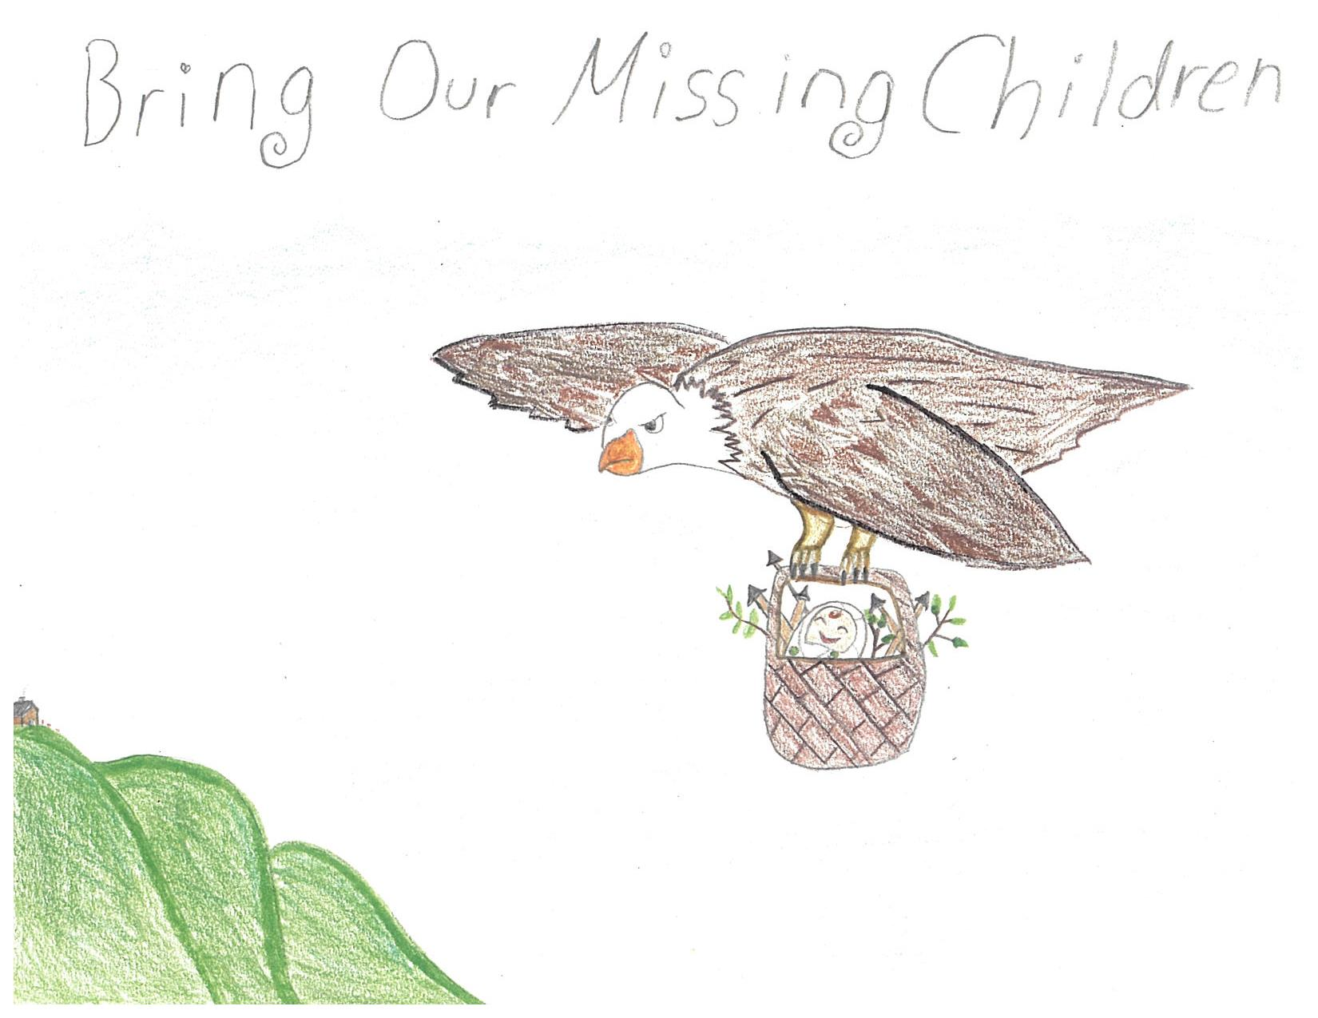
2016
Mia Larizzati

Slide 11
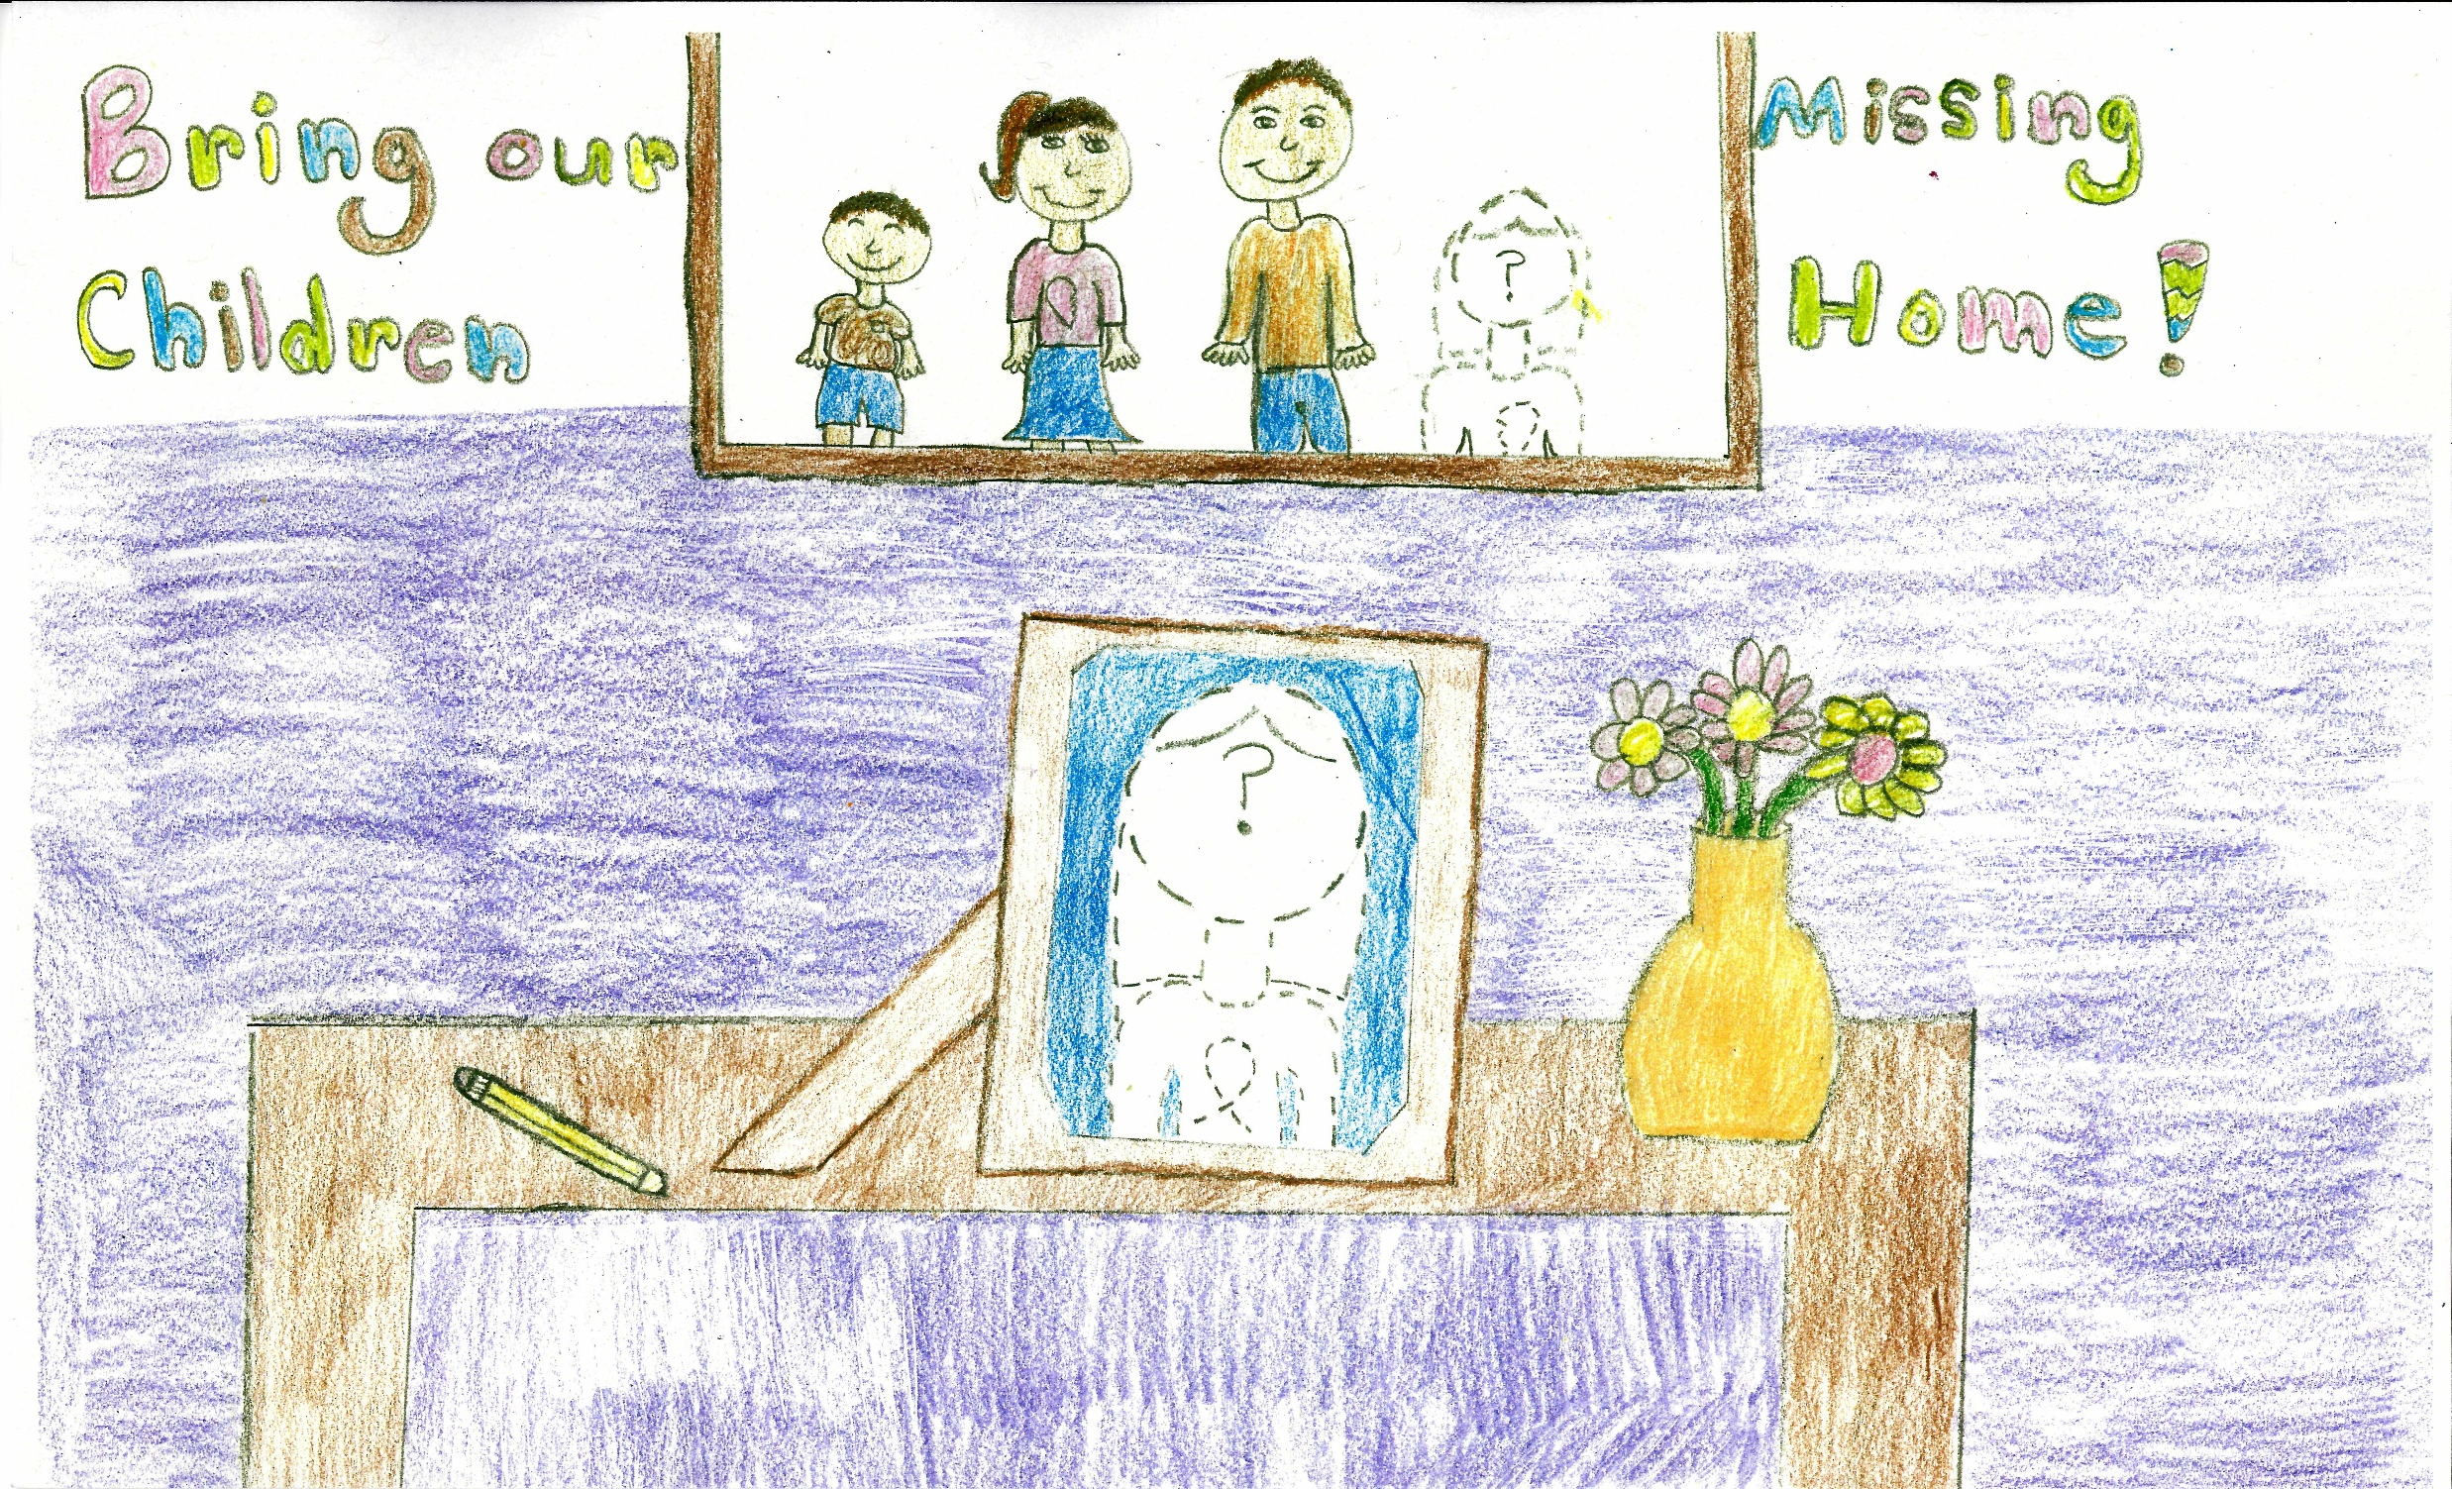
2015
Alena Weibel

